Slide 1
On spatial-temporal characters of Computation
Ian. King

Slide 2
Rumors & Fact
Lambda Calculus == Turing Machine?
Imperative Language==Turing Machine?
Functional Language == Lambda Calculus?
Functional Language == Imperative Language?

Slide 3
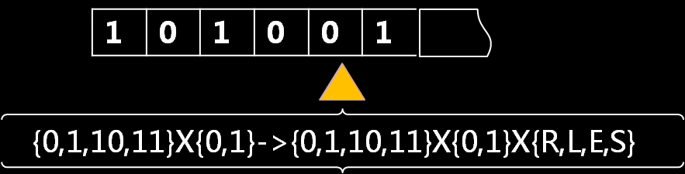
Where do these Rumors come from?
Where do they come from
Turing Machine
It seems difficult to dissociate the state transferring from variable assignment
Turing machine is not concerned with IO problem
Neither is Lambda calculus

Slide 4
A new picture
Imperative
Functional
Turing Machine
IO
Lambda
Calculus
IO
State Transfering
Assignment
Recursion
Monad
Assignment
Assignment State Transfer
Recursion State Transfer
Monad Assignment
<
<
Parallel programming
Serial programming

Slide 5
Why is state equivalent to recursion?
Mathematical Prove?
Elegant , Simple
Physical explanation
Rough , Plain
But only for Alien
Suitable for Human
the simplest memory circuit : flip-flop
Composite circuit is stateless
0 1
1 1
0 1
1 1
0
1
1 0

Slide 6
What's Assignment all about ? if it's irrelevant to state
It's soul of Von-Neumann architecture
It's nothing but IO
It causes the computation to advance at all
Control statements simply determine
which of the assignment statements
will be executed.
Famous Quotes
“The primary statement in that world is the assignment
statement itself. All the other statements of the language exist in order to make it possible to perform a computation that must be based on this primitive construct: the assignment statement.”
John Backus, 1977 ACM Turing Award Lecture
<Can Programming Be Liberated from the von Neumann Style?>
memory
Clock
CU
R1
R2
Clock
ALU
A
B
Program counter
C
ALU

Slide 7
The Original Sin of Von-Neumann style
Historical perspective
“the machines' abilities for parallel operations made programming significantly more complicated. This taught him to focus on single-instruction code where parallel handling of operands was guaranteed not to occur”
<John von Neumann and the Origins of Modern Computing>
William Aspray 1990.
Theoretical perspective
Clock controls everything
Advantage
Simple: matches human intuition
Economical & flexible: scheduling IO arbitrarily
Temporally composability
continuous map between partially ordered set 1<2<3 f(x)=2*x, f(1)<f(2)<f(3)
for, foreach,map
Thread ,process
Disadvantage: It's a long story

Slide 8
The Original Sin of Von-Neumann style
In essence , IO means Clock synchronization &communication.
Signal passing is the only way to synchronize clocks
Theory of relative : Light signal
Von-Neumann architecture: Signal polling
clock controls everything implies that external signal controls nothing.
Signal polling causes memory wall (such as context switch)
Invariant Signal passing is the only way to eliminate paradox
Theory of relative : speed of light is constant
Von-Neumann architecture: Atomic exchange instruction
Atomic exchange instructions causes lock
Lock is the road to chaos (dead lock, race condition…..)

Slide 9
The Original Sin of Von-Neumann style
The “dark side” of Von-Neumann architecture may in fact mirror a fundamental complexity of our real world.
Assignment is an implicit concurrency IO operation.
Von Neumann opened a Pandora-Box, while starting a new Era.

Slide 10
What’s Monad all about?
Let aliens worry about mathematical theory.
Case Study
Unix pipe-line is Monad
cat sample.txt|grep "High"|wc –l .cat
The difference between assignment and monad.
Advantage
Data flow controls everything
Message passing while data flowing
Compatibility of time uncertainty
Spatial composability
Topology homeomorphism
Disadvantage
Inflexible
Expensive, if communication facility is much more cheaper than computation unit
txt
cat
grep
wc
X=readint()
Y=X+3
writeint Y
Read (Input)
control unit
Read f= f (readint())
Add f= \x->f(x+3)
Write x= writeint (x)
Read $ Add $ Write
(mem )X
=
Readint() (IO)
Add (ALU)
(mem )Y
=
X+3 (ALU)
(IO) Print
Y (Mem)
Write(output)

Slide 11
Temporal Vs Spatial
B
X
C
R1
R1=x
R2=A*R1
R2=R2+B
R2=R2*R1
Y=R2+C
R2
A
+
A
B
C
+
ALU
Y
ASIC
Spatial Computation
Parallel
Inflexible
CPU
Temporal Computation
Sequential
Flexible

Slide 12
OO is sequential linear DataFlow
Inheritance describes a sort of linear data flow among objects
“OO is really all about message passing between objects”----Alan Kay
Inheritance doesn`t involve concurrency and non-linear interaction.
Inheritance structure cannot be altered in runtime.
Is inflexibility incurable?
Class Window
{abstract draw()…..}
Class Button extends Window {abstract draw()…..}
Class Image_Button extends Button
{abstract draw()…..}
Draw
window
Button
Image_Button

Slide 13
Don‘t tell me we can’t change! Yes we can.Yes we can change.
Their complementary characters build up a new architecture——reconfigurable computation
time
X
Y
mul in in
mul 01in
mul o2 π
add o3 4
div o4 3
ALU
ALU
ALU
ALU
ALU
X
Y
mul in in
mul 01A
mul in B
add o2 o3
add o4 C
ALU
ALU
ALU
ALU
ALU
space
Dynamic language is reconfigurable dataflow

Slide 14
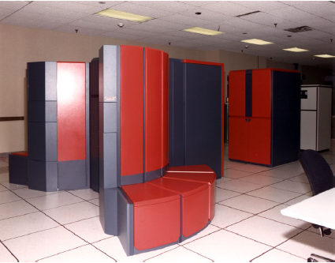
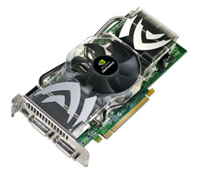
GPGPU the reconfigurable parallel data flow device
Modern GPU Similarity with vector processors (Cray supercomputers, etc.):
both amortize instruction decode over a long data vector (or stream)
both expose data parallelism by operating on large data aggregates
Modern GPU contains numerous stream processors
GeForce 8800 has 128 x 4-tuple processors (512-way parallel)
Quad Core is just a toy.
1990:500 M FLOPS
2008:500 G FLOPS~1 T FLOPS
It is a terrible waste to restrict gpu to play game

Slide 15
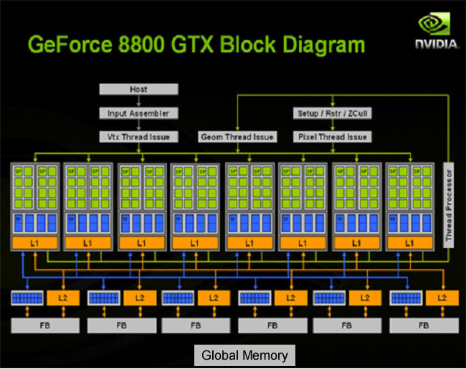
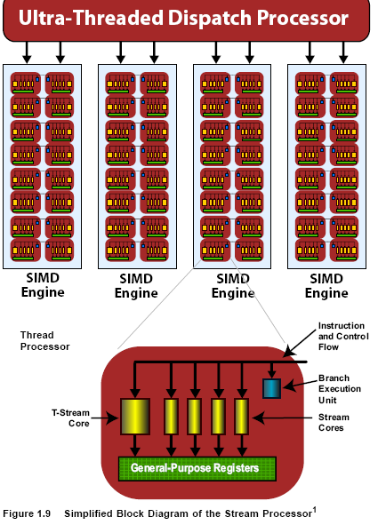
Stream processor
MIMD(scalar processor)
SIMD(vector processor)

Slide 16
Dataflow programming in GPGPU
NVIDIA CUDA: flexible but low-level and complicated
AMD stream SDK(Stanford Brook): easy to program, but lacks of advance features.
A sample of AMD stream SDK
kernel sum(float a<>,float b<>,out float c<>) { c=a+b; }
kernel mul(float a<>,float b<>,out float c<>) { c=a*b; }
main()
{ float input_a[10];float a<10>;
…..
streamRead(a,input_a);
streamRead(b,input_b);
streamRead(d,input_d);
sum(a,b,c);
mul(c,d,e)
streamWrite(e,output_e)
}

Slide 17
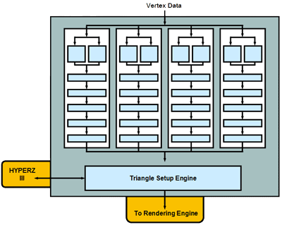
stream processor
Traditional Vertex Shader
Operates on 4D vector
vector applies on single instruction(+,-,*…) parallely in 1 clock cycle
( x, y, z, w )
( nx, ny, nz )
( s, t, r, q )
( r, g, b, a )
( x’, y’, z’, w’ )
( nx’, ny’, nz’ )
( s’, t’, r’, q’ )
( r’, g’, b’, a’ )
Stream processor
A stream processor works with streams and kernels
Stream: Set of data
Kernel: Small program
Stream processors take streams as input, execute kernel on every element of stream, outputs new streams

Slide 18
Dataflow programming in GPGPU(2)
split
streamRead
a
join
c=a+b
split
d
Stream processor
streamRead
b
e=c*d
streamWrite
streamRead
c
Brook API is less readable while manipulating complicated dataflow interaction.
Only support primitive datatypes (int ,float,double).
It is not capable of MIMD without support of low-level hardware API.
It is not capable of data dependency stream, such as Fibonacci stream.

Slide 19
Datarush a java dataflow library based on multi-core
Extensible& low learning curve
OO-based architecture for easily developing highly scalable applications
Provide high level dataflow constructs
XML based dataflow language
Graphic design tools based on Eclipse or Net Beans
Support traditional facility(JDBC,RMDB,JMX….)
Support most of parallel style
B
C
B1
B2
A
B
C
A
B
C
D
A
C1
C2
B
C
D1
D2
pipeline
SIMD
MIMD

Slide 20
Dataflow programming in DataRush
Program represented as a directed graph
Node is a java object represented as a computation unit
Edge is a set of xml data represented as dataflow direction
Node
public class SampleFilter extends DataflowNodeBas {
private IntInput y;
private IntOutput z;
private int x;
public SampleFilter(IntFlow source, int x) {
this.x = x;
y = newIntInput(source, "y");
z = newIntOutput("z");
}
public void execute() {
while (y.stepNext()) {
if (x >= y.asInt()) {
z.push(x);
} else {
z.push(y.asInt());
}
}
z.pushEndOfData(); }
Flow
<?xml version=“1.0” encoding=“UTF-8” standalone=“no”?>
<AssemblySpecification>
<Contract>
<Inputs>
<Port name=“InputY" type=“integer"/>
</Inputs>
<Outputs>
<Port name="OutputZ" type="integer"/>
</Outputs>
</Contract>
<Composition>
<Process instance=“SampleFilter" type=“SampleFilter ">
<Link source="InputY" target="y" />
</Process>
<Link instance=“SampleFilter" st="z"/>
</Composition>
</AssemblySpecification>

Slide 21
Dataflow programming in DataRush
Performance & Scalability are restricted by JVM
OO and XML sucks
OO is less composable
XML is unreadable
Graphic tools is a trinket
There is nothing about data dependence

Slide 22
There is no silver bullet yet
Each form of parallelism is domain specific
Data parallelism is only capable of data-transparency stream
Task parallelism operates more efficiently on data-dependency stream
SIMD is suitable for vector stream
MIMD is suitable for scalar stream
We need a language to cover all dirty works
A strong type system can provide tons of information for assembling parallel policies
Data type indicates the most efficient computation unit
Stream type indicates different parallelism form
A concise and compsoable DSL
Transformation between vector and scalar
Composite Data parallelism and Task parallelism
smoothly.
Haskell maybe an ideal candidate
Dataflow Language
Task
Parallelism
Data
Parallelism
OS
Scheduling
Hardware
Assembly
Multi-core
GPGPU

Slide 23
distinguish different data stream forms
Haskell internal list is represented as data-dependency steam and suitable for Cpus
map:: a→b→[a] →[b]
f(x)=x*2 => (map f) [1,2,3] =>[2,4,6]
Zip::[a]→[b] →[(a,b)]
Zip [1,2,3] [4,5,6] =>[(1,4),(2,5),(3,6)]
unzip:: [(a,b)] → ([a],[b])
Other helper functions
uncurry:: (a → b → c) → (a,b) → c
f a b =a+b => f 2 3 =6
k=uncurry f => g (2,3)=6
flip:: (a → b → c) → (b → a → c)
f a b=a/b => f 2 6 =3
k=flip f => k 6 2= 3
. ::(a → b) →(c → a) → c → b
show :: int->string => show 30=“30”
f a=a*a
k= show.f => k 5=
id :: a → a
id 3 =>3

Slide 24
distinguish different data stream forms
Haskell GHC.Parr is represented as data-transparency stream
Parr uses [::] to indicate the data-transparency array
mapP:: a→b→[:a:] →[:b:]
ZipP::[:a:]→[:b:] →[:(a,b):]
unzipP:: [:(a,b):] → ([:a:],[:b:])
Representation of Parr depends on element type
data instance [:double:]= AD ByteArray
data instance [: (a,b):]=AP [:a:] [:b:]
zipP and unzipP are constant time!
zipP as bs=AP as bs
unzipP (AP as bs)=(as,bs)
It will be divided into chuncks running on different processors in run time.
Whether or not use GPU depends on hardware equiments,datatypes and implementation
AP

Slide 25
Use Arrow to compose everything
Arrows are a new abstract view of computation
A computation takes inputs of some type and produces outputs of another type.
Definitions
class Arrow arr where
arr :: (a → b) → arr a b
(>>>) :: arr a b → arr b c → arr a c
(&&&) :: arr a b → arr a c → arr a (b,c)
(***)::arr a b → arr c d → arr (a,c) (b,d)
first :: arr a b → arr (a,c) (b,c)
second::arr a b → arr (c,a) (c,b)
loop::arr (a,c) (b,c) → arr a b
newtype SF a b=SF{runSF :: [:a:] →[:b:]}

Slide 26
Use Arrow to compose everything
Lift function to a composable computation
arr :: (a → b) → arr a b
Implementation of function
arr f = f
f x =x*x
k=arr f
k3= 9
Implementation of stream
arr f= SF $ mapP f
f x=x*x
k= arr f
runSF $ k [:1,2,3:]=[:1,4,9:]
f

Slide 27
Use Arrow to compose everything
compose two computation
(>>>) :: arr a b → arr b c → arr a c
Implementation of function
f (>>>)g = f flip (.) g
show :: int->string => show 30=“30”
f x=x*x
k=f >>> show
k 3= f flip (.) show 3= show . f 3 =show 9=“9”
Implementation of stream
SF sf >>> SF sg = SF (sf >>> sg)
f x=x*x
g x= x/2
k= arr f >>> arr g
= SF (mapP f >>> mapP g)
= SF (mapP g . mapP f)
runSF $ k [:1,2,3:]
= mapP g . mapP f [:1,2,3:]
= mapP g [:1,4,9:]
=[:0.5, 2.0, 4.5:]
f
g

Slide 28
Use Arrow to compose everything
Apply a scalar to parallel computation
(&&&) :: arr a b → arr a c → arr a (b,c)
Implementation of function
(f &&& g) a = (f a , g a)
show :: int->string => show 30=“30”
f x=x*x
k=f &&& show
k 3= (f 3,show 3)=(9,”3”)
Implementation of stream
SF f &&& SF g =SF $ f &&& g >>> uncurry zipP
f x=x*x
g x= x/2
k= arr f &&& arr g
= SF $ mapP f &&& mapP g >>> uncurry zipP
= SF $ uncurry zipP . \[:x:] →(mapP f [:x:], mapP f [:x:])
runSF $ k $ [:1,2,3:]=runSF (k) ([:1,2,3:])
= uncurry zipP . \[:x:] →(mapP f [:x:], mapP f [:x:]) [:1,2,3:]
= uncurry zipP .([:1,4,9:],[:0.5,1.0,1.5:])
==[:(1,0.5),(4,1.0),(9,1.5):]
f
g

Slide 29
Use Arrow to compose everything
apply a vector to parallel computation
(***)::arr a b → arr c d → arr (a,c) (b,d)
Implementation of function
(***) f g ~(x,y) = (f x , g y)
show :: int->string => show 30=“30”
f x=x*x
k=f ***show
k (3,4)= (f 3, show 4)=(9,”4”)
Implementation of stream
SF sf *** SF sg= SF $ unzipP>>>sf *** sg>>>uncurry zipP
f x=x*x
g x= x/2
k= arr f *** arr g
= SF $ uncurry zipP . f *** g. unzipP
= SF $ uncurry zipP . \(xs,ys)->(mapP f xs, mapP g ys). unzipP
runSF $ k $ [:(1,4),(2,5),(3,6):]
= uncurry zipP . \(xs,ys)->(mapP f xs, mapP g ys). unzipP [:(1,4),(2,5),(3,6):]
= uncurry zipP . \(xs,ys)->(mapP f xs, mapP g ys) . ([:1,2,3:],[:4,5,6:])
= uncurry zipP .([:1,4,9:],[:2.0,2.5,3.0:])
= [:(1,2.0),(4,2.5),(9,3.0):]
f
g

Slide 30
Use Arrow to compose everything
apply a scalar of vector to Computation, with the rest copied through to the output.
first :: arr a b → arr (a,c) (b,c)
Implementation of function
first f = f *** id
id a=a
f x=x*x
k=first f
k (2,3)=(f 2,id 3)=(4,3)
Implementation of stream
first (SF sf) = SF $ unzipP >>> first sf >>> uncurry zipP
f x=x*x
K=first arr f
= SF $ uncurry zipP . first mapP f. unzipP
= SF $ uncurry zipP . \(xs,ys)->(mapP f xs, id ys). unzipP
runSF $ k $ [:1,2,3:]
= uncurry zipP . \(xs,ys)->(mapP f xs, id ys). unzipP [:(1,4),(2,5),(3,6):]
= uncurry zipP . \(xs,ys)->(mapP f xs, id ys) . ([:1,2,3:],[:4,5,6:])
= uncurry zipP .([:1,4,9:],[:4,5,6:])
= [:(1,4),(4,5),(9,6):]
f

Slide 31
Use Arrow to compose everything
Compose data-dependency stream
loop::arr (a,c) (b,c) → arr a b
Implementation of data-dependency stream
loop (SF f)=SF $ \as →
let (bs,cs)=unzip $ f $ zip (fromP as) $ stream cs in toP bs
where stream ~(x:xs)=x:stream xs
Hat trick
Two helper function, toP::[a] →[:a:]，fromP::[:a:] →[a]
Every Haskell variable has two values, bound value and bottom.
T=1,T has a bound value 1
T, T has a bottom⊥, which means unknown value and is total different from null or undefined semantics in popular language.
The ~ in the definition of stream indicates Haskell’s lazy pattern matching, whose arguments (x:xs) will not be evaluated until x are actually bound.
Semantically, stream ~(x:xs) will return an infinite list ⊥ : ⊥ : ⊥ : ....
f

Slide 32
Sample
Newton Interpolation & Rectangle Integral
Given points of a curve , calculate the area under the curve between[a,b].(The divided differences of points are given for convenience)
Use Newton interpolation to fit the curve
The terms of polynomial is a data-dependency sequence.
Terms(x,(xi:xs),t,[r])->Terms(x,xs, t*(x-xi), t*(x-xi):[r])
a
x0
x1
x
x2
b

Slide 33
Sample
loop (SF f)=SF $ \as →let (bs,cs)=unzip $ f $ zip (fromP as) $ stream cs in toP bs
where stream ~(x:xs)=x:stream xs
k=runSF$ loop $ (arr (term 0.56) >>> (arr id &&& delay 1))
term x = \(t,t')-> t'*(x-t)
delay x= SF (\y->x:y)
>>>
(0.65,c3)
(0.55,c2)
(0.40,c1)
term x
0.65
0.55
0.40
c3*(x-0.65)
c2*(x-0.55)
c1*(x-0.40)
zip
c3
c2
c1
&&&
id
c3*(x-0.65)
c2*(x-0.55)
c1*(x-0.40)
c2*(x-0.55)
c1*(x-0.40)
1
1
c1*(x-0.40)
c2*(x-0.55)
c3*(x-0.65)
delay 1
unzip
(c3*(x-0.65),
c2*(x-0.55))
(c2*(x-0.55),
c1*(x-0.40))
(c1*(x-0.40)
,1)
c3*(x-0.65)
c2*(x-0.55)
c1*(x-0.40)
output

Slide 34
Speed up loop
the only way to speed up is Task parallelism
Theoretically，Cilk –work stealing achieves T_{P} = T₁/P + O(T∞)
T∞ means critical-path length.
evaluator 2
1
0.56
c1
*
x-0.40
x-0.55
c2
*
x-0.55
evaluator 3
c3
*
x-0.65
x-0.65
evaluator

Slide 35
Arrow DSL
Arrow is composable but still unreadable
newton::Float->(([:(Float,Float):],Float)->Float)
newton x = (first $ (runDSF $ (first $ loop $ (arr term x>>> (arr id &&& delay 1))>>> arr (\(x,y)->(x * y)) ) >>> sumP)>>> arr (\(x,y)->x+y)
Arrow notation——a more concise Dsl for dataflow programming
Definition
proc pat ->a -<e ➔ arr (\pat->e)>>>a
proc pat -> do x <- c1 ➔ (arr id &&& proc pat -> c1) >>> proc (pat,x) -> c2
c2
Sample
addA f g =
proc x -> do y <- f -< x
z <- g -< x
returnA -< y + z
f
+
g

Slide 36
Rectangle integral
Calculate grads
grads a step= arr \s->a+s*step
Calculate area of rectangle
rectangle l w=l*w
Integral
Integral a step=proc steps->
gs<-grads a step-<steps
fxs<-newton-<gs
rect_areas<-rectangle-<(fxs,gs)
returnA sumP rect_areas
Integral a step $ [:1..truncate (a-b)/step:]
a
x0
x1
x
x2
b

Slide 37
Future works
We need a more popular language instead of spicy Haskell
An efficient backend for GpGpu
An improved VM support work-stealing

Slide 38
Thank you

Slide 39
The Original Sin of Von-Neumann style
In essence , IO means Clock synchronization &communication.
Signal passing is the only way to synchronize clocks
Theory of relative : Light signal
Von-Neumann architecture: Signal polling
clock controls everything implies that external signal controls nothing.
Signal polling causes memory wall (such as context switch)
IO
Memory wall
CPU
time’
time

Slide 40
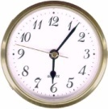
The Original Sin of Von-Neumann style parallelism
Invariant Signal passing is the only way to eliminate paradox
Theory of relative : speed of light is constant
Von-Neumann architecture: Atomic exchange instruction
Atomic exchange instructions causes lock
Lock is the road to chaos (dead lock, race condition…..)
Dataflow programming in DataRush
Ta
Tb
Register B
mov A,B
Register A
xchg B,A
Ta’
time’
If light speed is variant, we must measure speed first.
If we want to measure speed, we must know how much time light takes to travel .
……………
If speed is constant:
Tb=Ta+(Ta’-Ta)/2
time
mov B,A
Assignment is a sort of one way data flow
Synchronization must be a bidirectional data flow
If we want to synchronize data, we must synchronize instructions’ sequence.
If we want to synchronize instruction's sequence ,we must synchronize data

